Slide 1

Vehicle Insurance Interest Analysis
By A.A

Slide 2
Introduction
This project focuses on conducting a probability analysis using a dataset of vehicle insurance. The dataset includes valuable information on demographics, vehicles, and insurance policies. Demographic factors such as gender, age, and region code type, along with vehicle-related data like vehicle age and damage, are analyzed. The insurance policy details, including premium and sourcing channel, are also considered.
The objective of this analysis is to examine the probabilistic relationships between these variables and gain insights into the factors that affect vehicle insurance and the interests of customers to join the vehicle insurance.
The insights of this analysis are valuable to the Vehicle Insurance Agents, Insurance Agents are professional who makes sure individuals are protected from life-threatening illnesses or unfortunate accidents. They negotiate and buy coverage to fit any need, whether you’re an individual looking for health insurance or a business owner needing property protection. Insights from the analysis will help Vehicle Insurance Agents predict customer interest and tailor their strategies.

Slide 3
Descriptions of features
id : Unique ID for the customer
Gender : Gender of the customer
Age : Age of the customer
Driving_License False : Customer does not have DL, True : Customer already has DL
Previously_Insured Yes : Customer already has Vehicle Insurance, No : Customer doesn't have Vehicle Insurance
Vehicle_Age : Age of the Vehicle
Vehicle_Damage Yes : Customer got his/her vehicle damaged in the past. No : Customer didn't get his/her vehicle damaged in the past.
Annual_Premium : The amount customer needs to pay as premium in the year
Vintage : Number of Days, Customer has been associated with the company
Response: Customer is interested, Customer is not interested

Slide 4
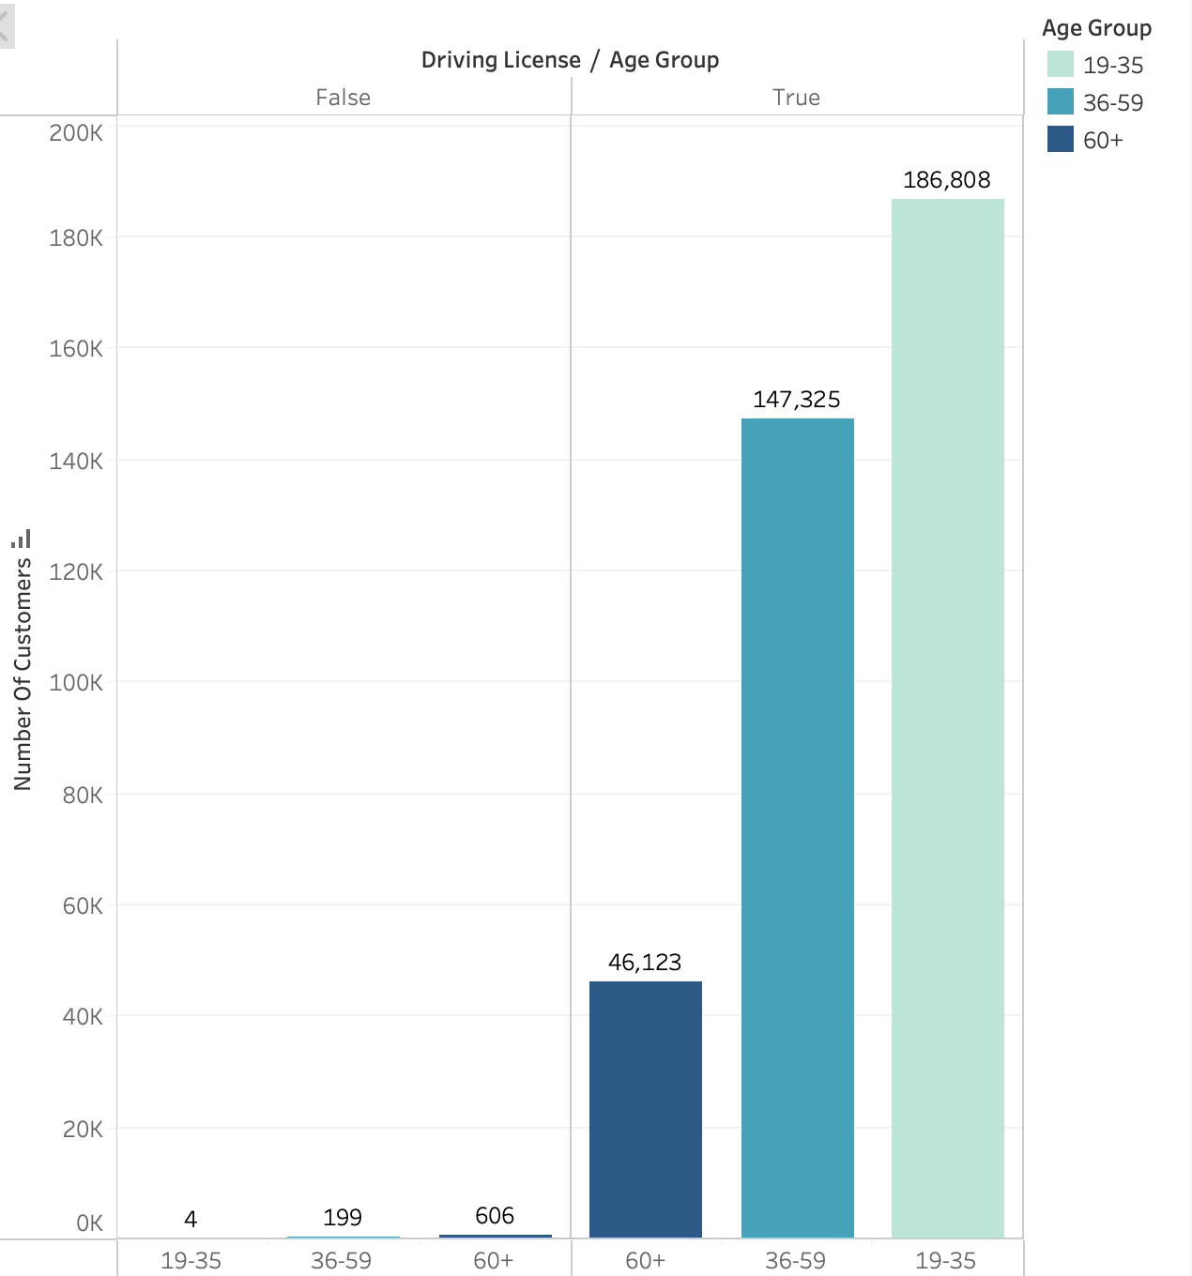
Distribution Of Drivers Licenses With Age Group
Notes:
Looking into Customers who do not have drivers license, the highest number is on people with 60+ years, reasons could be:
Health Issues: Age-related health conditions such as vision problems, hearing impairment, reduced motor skills, or cognitive decline can affect driving ability.
Safety Concerns: They might voluntarily surrender their licenses due to concerns about their own safety or the safety of others on the road.

Slide 5
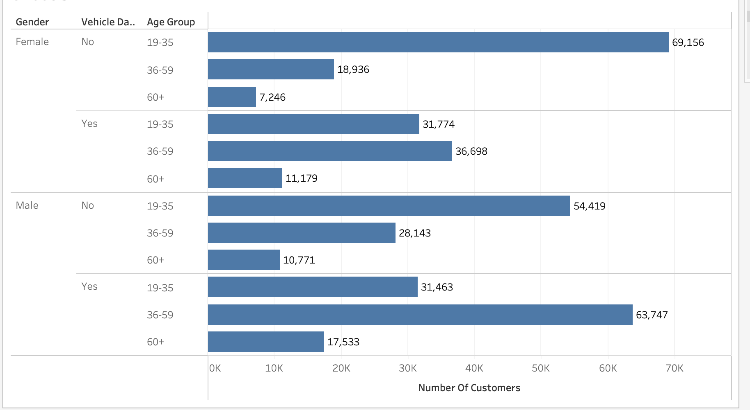
Number Of Customers Who Had Damaged Vehicles By Gender And Age Group
Notes:
Customers who had most damaged cars for both genders range between 36-59 age group, this could be because of: Driving Frequency: People in this age group are often in the prime of their careers and personal lives, leading to more frequent driving for work, family activities, and social events. Increased time on the road can increase the likelihood of accidents or wear and tear.
Family Responsibilities: Individuals in this age group are often responsible for transporting children and teenagers, who might cause accidental damage to vehicles (e.g., spills, scratches, and minor collisions).
Longer Car Ownership: People in this age group might own their cars for longer periods, leading to accumulated damage over time.
Higher Stress Levels: Balancing work, family, and other responsibilities can lead to higher stress levels, potentially impacting driving behavior and increasing the risk of minor accidents or vehicle damage.
Busy Lifestyles: The busy nature of this life stage might result in less time for regular car maintenance, leading to more wear and tear.
Higher Mileage: Commuting to work, running errands, and taking family trips contribute to higher mileage, which can lead to more wear and tear and potential damage over time.
Urban Living: Many people in this age group live in urban or suburban areas with heavy traffic and limited parking, increasing the chances of minor accidents and vehicle damage.

Slide 6
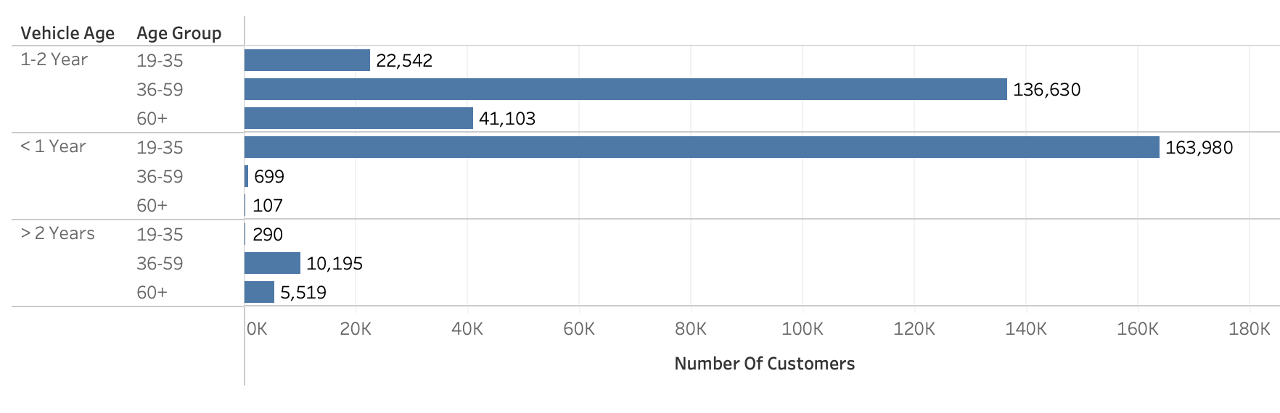
Distribution Of Vehicle Age By Age Group

Slide 7
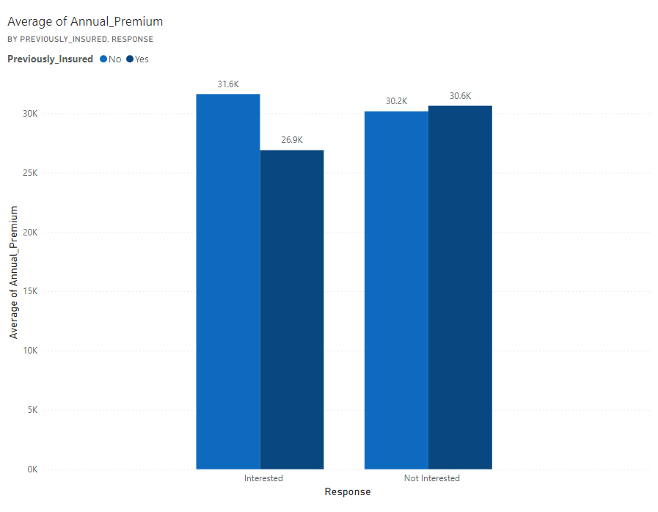
Distribution Of Customer Response By Annual Premium And Previously Insured

Slide 8
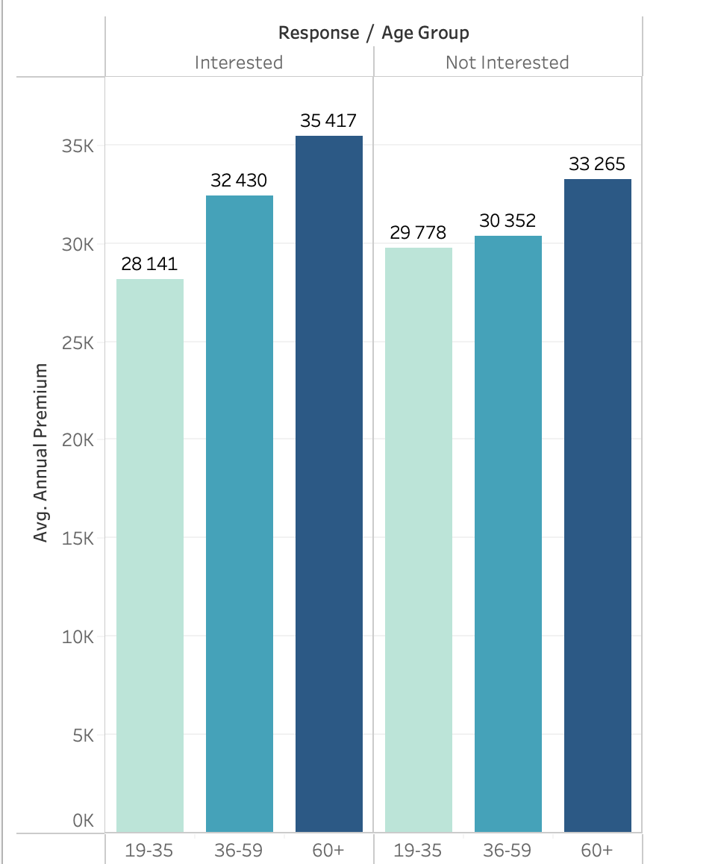
Response Based On Average Annual Premium And Age Group

Slide 9
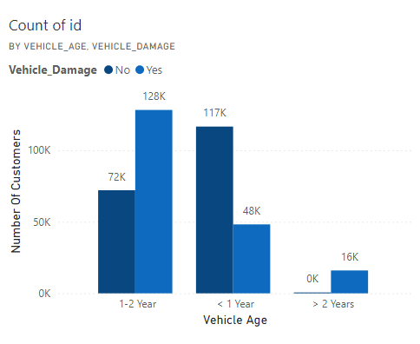
Number Of Customers With Damaged Vehicles By Vehicle Age

Slide 10
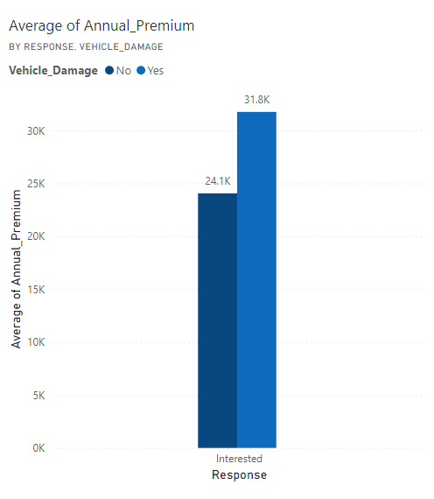
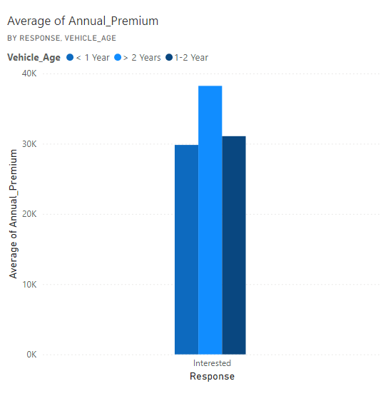
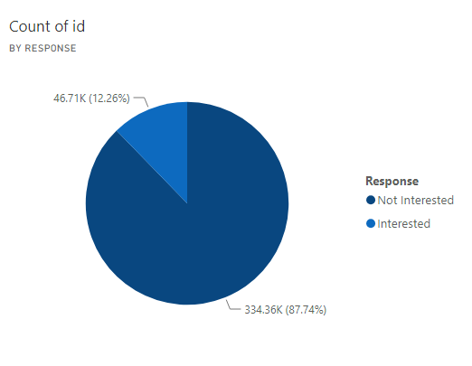

Slide 11
Conclusion
These insights are instrumental for Vehicle Insurance Agents, enabling them to better understand their target market and predict customer behavior. By leveraging these findings, agents can tailor their strategies, enhance customer engagement, and optimize their offerings to meet customer needs effectively.

